Slide 1
CLAS 220: Introduction to Classical Mythology
Lecture 3: The Gods. The Homeric Hymns

Slide 2
Polytheism vs. Monotheism
Monotheistic religions (religions with one god), such as Judaism, Christianity and Islam, tend to see that god as omniscient, omnipotent and good
Monotheistic gods are often also abstract, maybe even unrepresentable
Polytheistic religions (with many gods), such as ancient Greek and Roman religion, and modern Hinduism, see the world as filled with divine forces of various kinds, not all benevolent, potentially competing with each other, overlapping, and potentially limitless in number
Different gods have different functions, but their division not always simple
Gods also generally much more human in behavior, and representation of the gods is important

Slide 3
In the beginning…
The major Greek text to give us a myth of the origin of the universe is Hesiod’s Theogony (c. 8 century BC); other versions definitely existed.
“In truth at first Chaos came to be, but next wide-bosomed Earth, the ever-sure foundation of all the deathless ones who hold the peaks of snowy Olympus, and dim Tartarus in the depth of the wide-pathed Earth, and Eros (Love), fairest among the deathless gods, who unnerves the limbs and overcomes the mind and wise counsels of all gods and all men within them.
From Chaos came forth Erebus and black Night; but of Night were born Aether and Day, whom she conceived and bore from union in love with Erebus. And Earth first bore starry Heaven, equal to herself, to cover her on every side, and to be an ever-sure abiding-place for the blessed gods.”

Slide 4
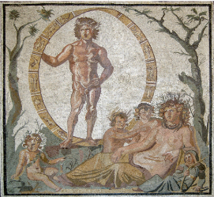
Gaia Γαῖα and Uranus Οὐρανός
Mother Earth and Father Sky
according to Hesiod’s Theogony, Gaia born of Chaos, creates Uranus as her husband
They give birth to twelve Titans.
their youngest son, Cronus, becomes his father’s rival, eventually castrates him
blood and semen from castration form Furies and Giants

Slide 5
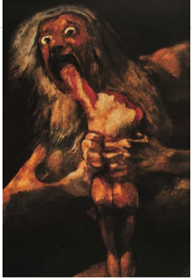
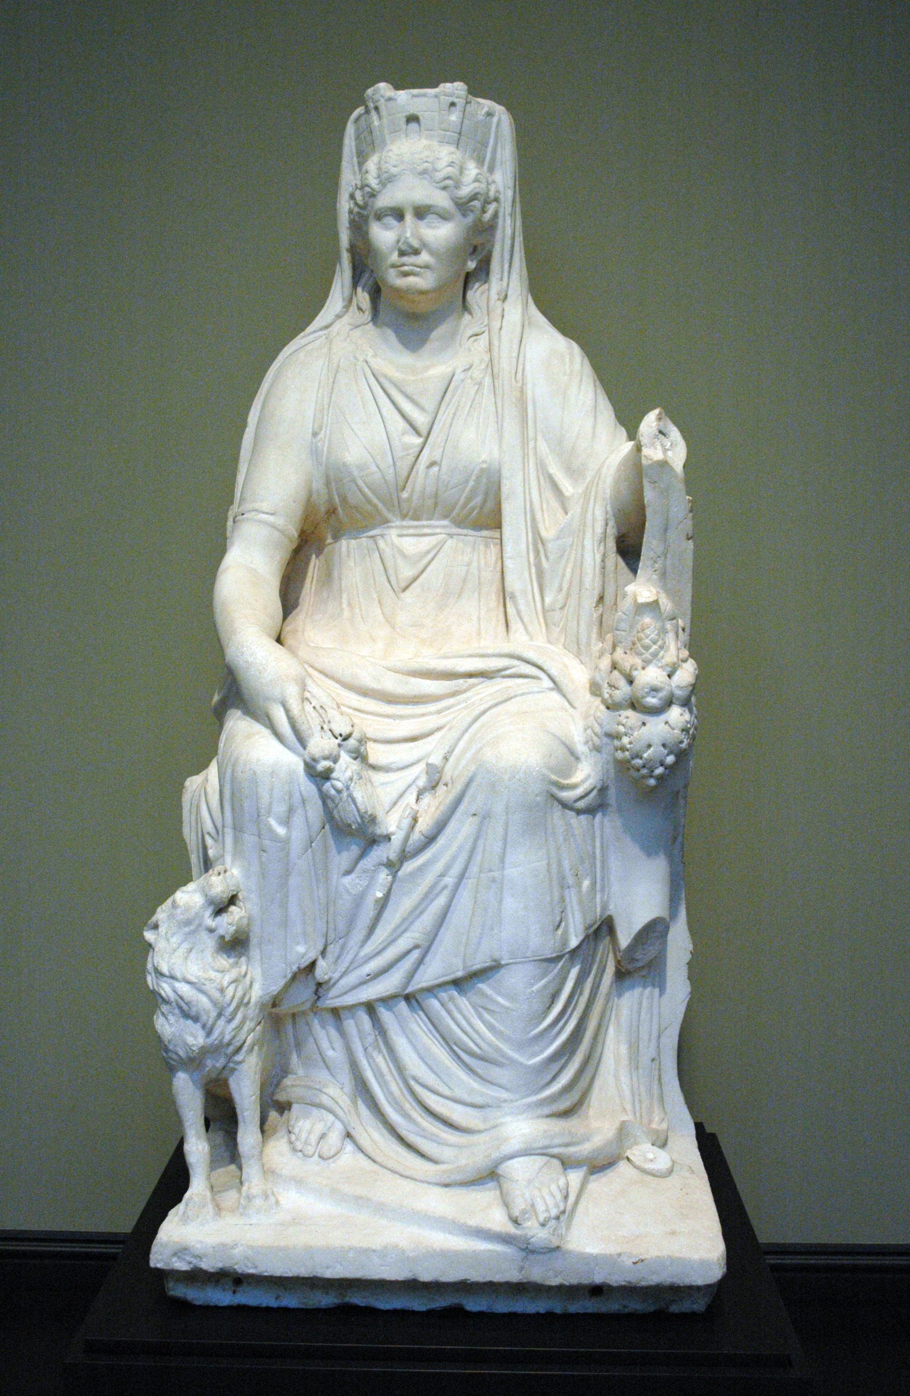
Cronos Κρόνος and Rhea Ῥέα
Cronos doesn’t want to repeat mistakes of father and thus eats his own children
Rhea saves the youngest of them (Zeus), feeds her husband a stone instead
Boy Zeus taken off to Crete, the Corybantes sing and dance when he cries so his father won’t hear him
Zeus returns and rescues his brothers and sisters
Rhea associated with the Great Mother goddess (Cybele), worshipped by ecstatic dancers

Slide 6
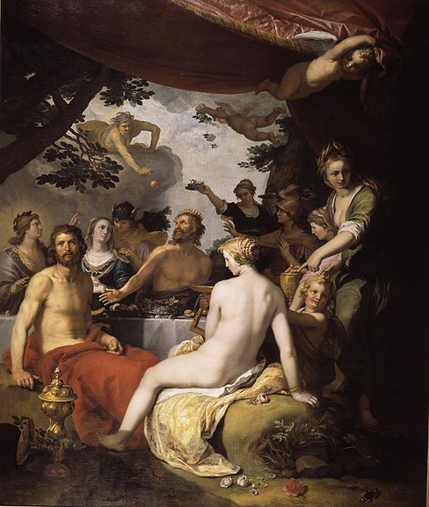
One more generation of gods?
We hear rumors of a story that the minor goddess Thetis was wooed by Zeus and his brother Poseidon, but then they heard a prophecy that she would bear a son greater than her father.
Their response? Marry her off to a mortal man, Peleus.
The son of Peleus and Thetis will be Achilles, hero of the Iliad.

Slide 7
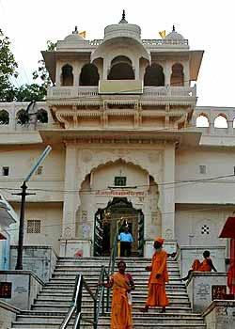
The early generations of gods
Cybele/Rhea/the Great Mother aside, none of the gods I’ve mentioned above are particularly important in practice.
Few temples
Few rituals
Few myths other than these geneaological ones
It’s with the generation of Zeus and his siblings (and the generation after him, that we get to the gods that matter…

Slide 8
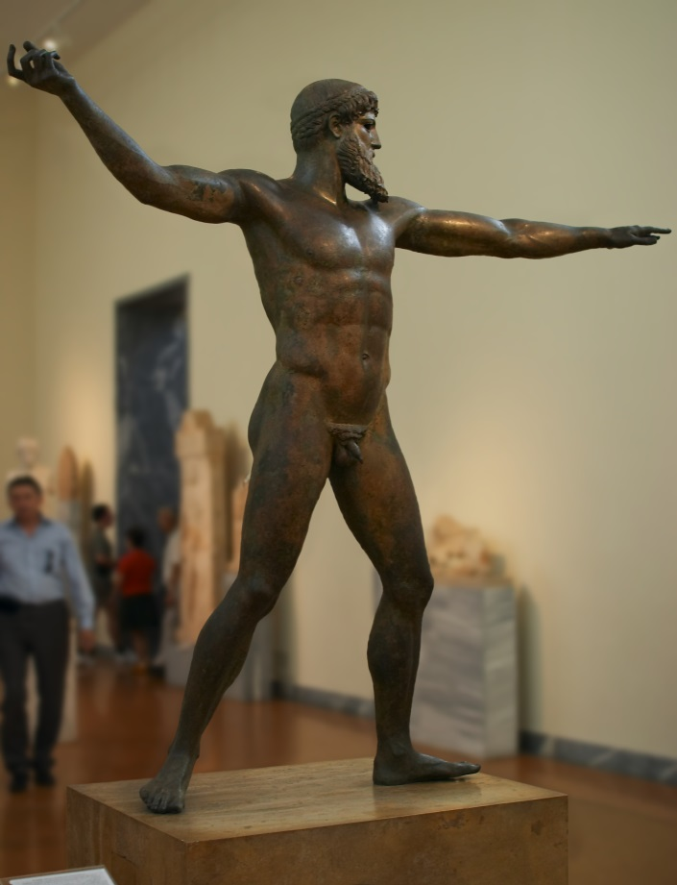
Zeus Ζεύς (Roman Jupiter, Jove)
Son of Cronos and Rhea
King of the Gods
Father of Heroes and Gods
God of clouds, thunder, lightning and rain
God of oaths and councils
God of Victory and Justice
God of hosts and guests
Worshipped everywhere, especially Olympia (games) and Dodona (oracle)

Slide 9
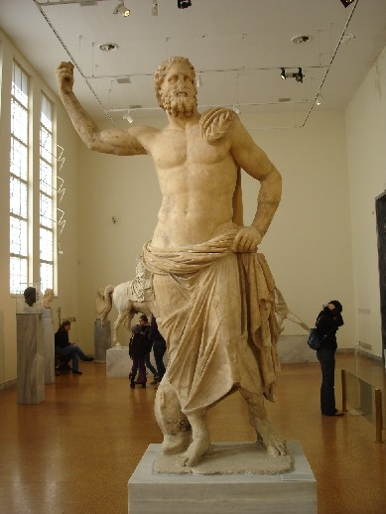
Poseidon Ποσειδῶν (Roman Neptune)
Brother of Zeus (and Hera)
God of the Sea (fishermen),
Earthquakes, horses, bulls
Divides the universe with his brothers Zeus (heavens) and Hades (underworld)
Archenemy of Odysseus, hero of the Odyssey

Slide 10
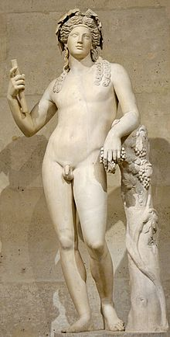
Dionysus Διόνυσος (Roman Bacchus)
Son of Zeus and mortal Semele, born from Zeus’ thigh
God of wine and its consequences
Young, slightly effeminate, but powerful
Foreign, yet Greek
Good worship – moderate drinking, theatre
Bad worship – maenads
Myths about humans who deny him

Slide 11
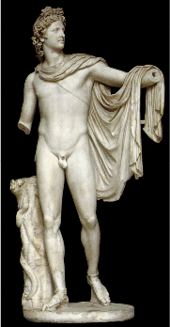
Apollo Ἀπόλλων (Roman Apollo)
Son of Zeus and the mortal Leto, twin of Artemis
a very Greek ideal of young masculinity,
god of the transition to manhood
Sometimes connected to the sun
hunting, archery, plagues and healing
music
associated with prophecy, especially Delphi
(slays the Python, takes over as god of Delphi)
Hostile to the Greeks in Homer
“know yourself” γνῶθι σεαυτόν
“nothing in excess” μηδέν άγαν

Slide 12
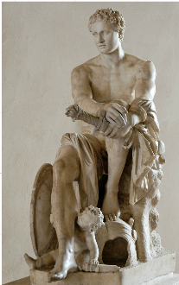
Ares Ἄρης (Roman Mars)
son of Zeus and Hera
god of war, especially of going berserk
violent, moody, cowardly, whiny
few myths, and little ritual
the dark side of war
(victory and strategy = Athena)

Slide 13
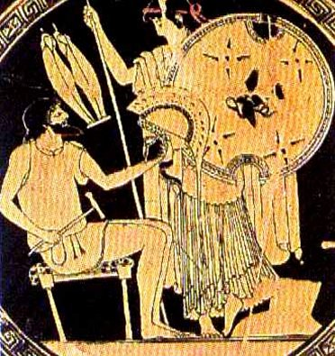
Hephaestus Ἥφαιστος (Roman Vulcan)
blacksmith god
son of Hera (alone or with Zeus)
lame, target of divine laughter
married to Aphrodite or to Charis (grace)
special worship in Athens, where his
near-rape of Athena is responsible for
birth of Erichthonius, the founding king
worshipped also on the (originally non-Greek)
island of Lemnos
Makes armor for Achilles in the Iliad

Slide 14
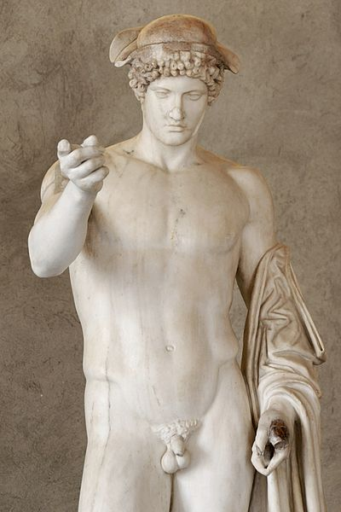
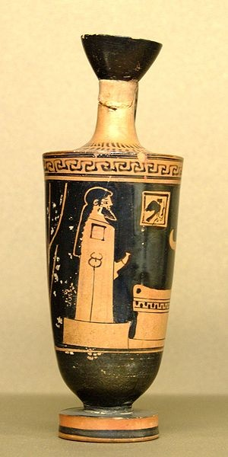
Hermes Ἥφαιστος (Roman Mercury)
Son of Zeus and Maia
messenger, trickster, thief
herdsman
invents lyre and fire, steals cattle of Apollo
(all on first day!)
god of boundaries
-- between life and death
-- between properties (herms)
-- adolescent masculinity

Slide 15
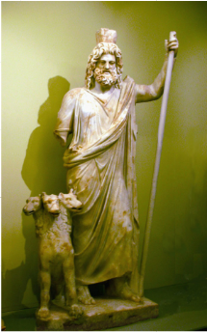
Hades Ἅιδης (Roman Plutus)
King of the Underworld,
groom of Persephone
associated with wealth (mineral, vegetal)
rarely spoken of, sacrifice with face averted

Slide 16
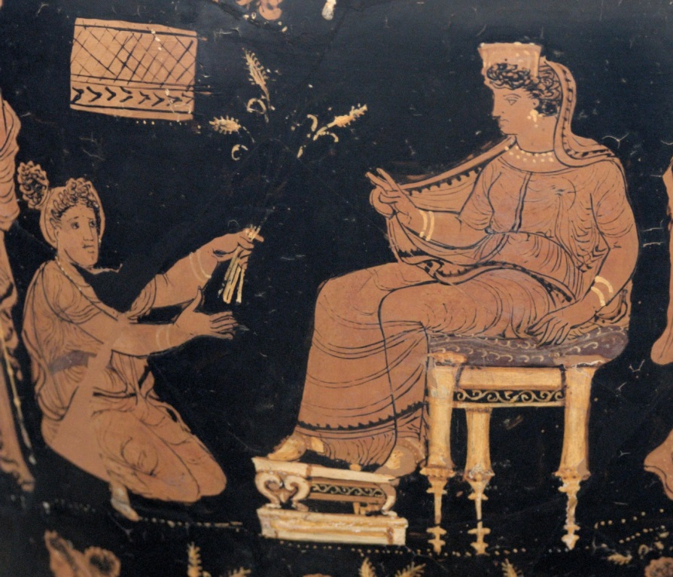
Homeric Hymns
short poems of praise to the gods, often include prayer
often describe ritual activity
probably began as preludes to performances of Homeric Epic (Iliad, Odyssey)
introduce key features of the god, and often tell an important myth
most important ones may date from Archaic period (i.e. before 500 BC)

Slide 17
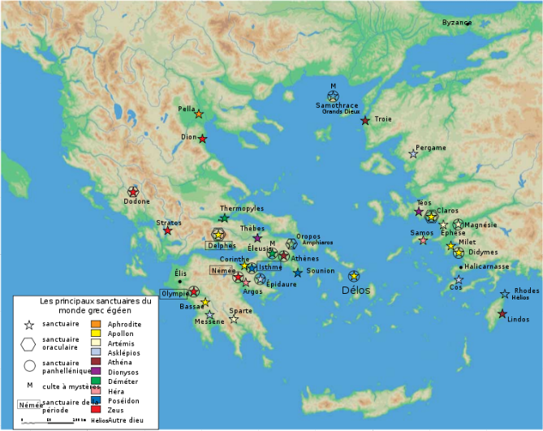
Homeric Hymn to Apollo

Slide 18
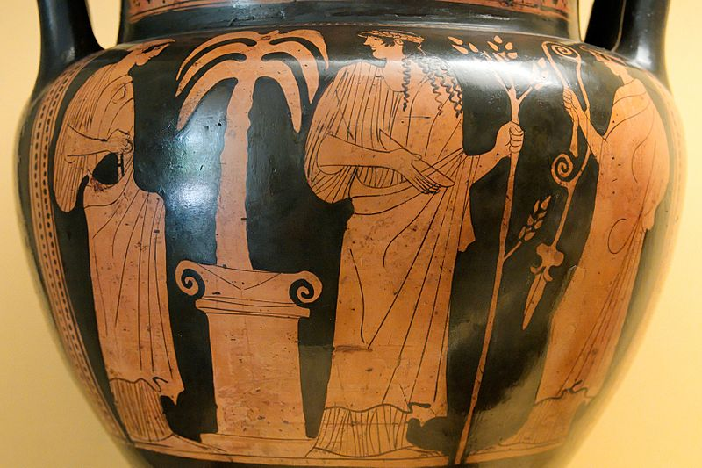
Homeric Hymn to Apollo
Zeus impregnates Leto, but no land on earth will allow her to give birth, until Delos does...
Forthwith Phoebus Apollo spoke out among the deathless goddesses:
“The lyre and the curved bow shall ever be dear to me, and I will declare to men the unfailing will of Zeus.”

Slide 19
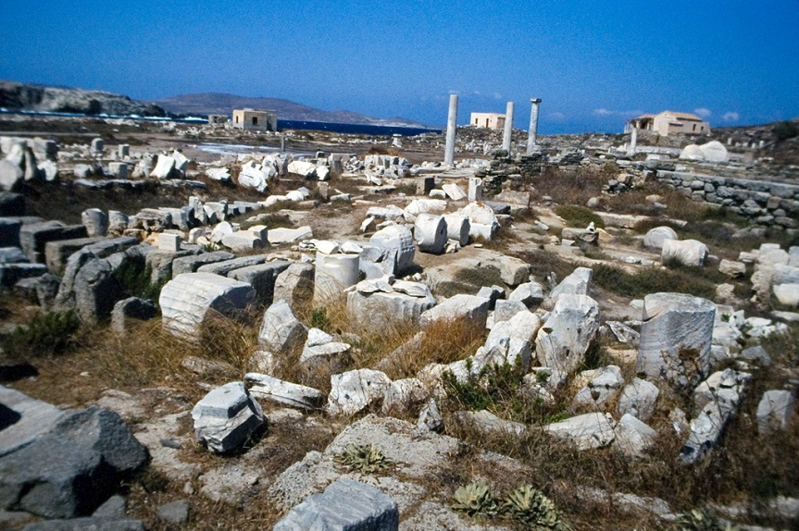
Homeric Hymn to Apollo
Yet your heart, Phoibos, most delights in Delos
where the Ionians, in trailing robes, gather
with their children and respected wives.
They please you when they hold their contests,
remembering you with boxing matches, dance and song.
…
And the greatest marvel, whose fame will never die:
the Delian girls, servants of the god of a hundred arrows.
They begin a hymn celebrating Apollo in song,
Leto next and Artemis, who rains arrows,
and then, remembering the men and women of old,
they sing an epic tale – they enchant the people.
They know how to mimic the sounds of all folk
and the rattling of castanets; each person would hear
his own voice singing, so well do they craft the song.
(146-150; 156-64)

Slide 20
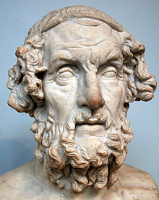
Homeric Hymn to Apollo
“Girls, which man’s song is sweeter to you
Of those landing here, and who delights you the most?
Then you all answer so well about us:
“The blind man, who lives in rugged Chios,
Whose songs all remain the best forever.”
We will carry your fame (kleos) so far over the earth
As we travel about the crowded cities of people.
They will be persuaded, since it is the truth.
(169-76)

Slide 21
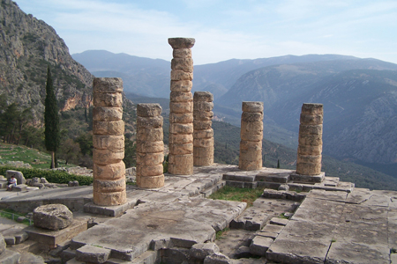
Homeric Hymn to Apollo
People living in the rocky Peloponnesus, in Europe,
and in islands encircled by sea will make offerings
when seeking an oracle. To all of them, I will prophesy
unerring counsel, declaring oracles in my rich temple.”
After speaking, Phoibos Apollo set the foundations
wide and continuous. The sons of Erginos,
Trophonius and Agamedes, dear to the immortal gods,
placed a marble threshold on the foundations.
The countless human race crafted a temple
with polished stones, a temple to be a song forever.
A lovely stream runs near, where the son of Zeus
used his mighty bow to kill a she-dragon,
a great, fat, wild monster, who persisted in wreaking
much evil on men – on the men themselves
and often on their rangy sheep – a very bloody bane.
(290-304)

Slide 22
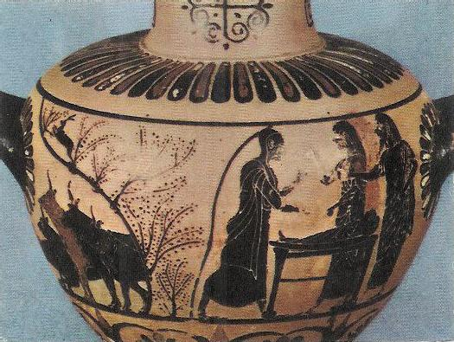
Homeric Hymn to Hermes
Maia bore a wily child with a seductive mind –
a robber, cattle rustler, guide of dreams,
who stands watch by night, guardian at the gate,
who would soon reveal glorious deeds among immortal gods.
Born at dawn, at midday he played the lyre,
at dusk he stole the cattle of Apollo the skillful Archer,
on that fourth day of the month Queen Maia bore him.
(13-19)
His heart delighted, Hermes pulled the rich meat
onto a smooth, flat stone and cut twelve portions
divided by lot, setting out each perfect prize.
Glorious Hermes craved the offering of meat,
for the sweet scent rubbed at him – him a god! –
but his manly sprit could not persuade him,
despite his great desire to shove it down his sacred throat.
Instead, he set all the meat and fat in the cave,
quickly lifting them high in midair,
a sign of his recent theft. (127-36)

Slide 23
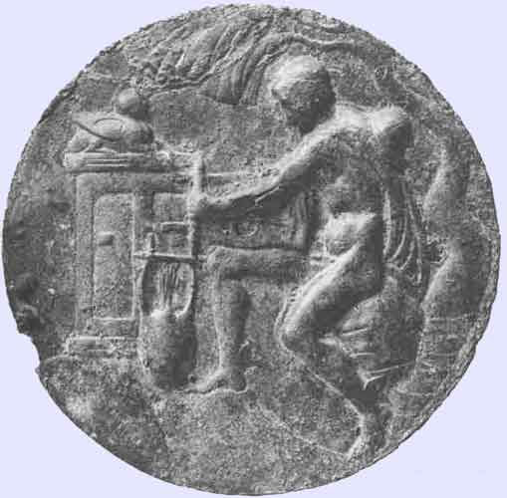
Homeric Hymn to Hermes: The two songs of Hermes
“Like young men provoking each other at feasts,
The god sang along beautifully with the lyre,
Improvising tales of the amorous love talk
Between Kronos’ divine son and Maia in fine sandals:
Hermes celebrated in song his own famous conception.”
(55-59)
“Soon he played a high,
Sweet prelude, his lovely voice following after,
Celebrating the immortal gods and dark Earth,
How things came to be, and how each won his lot.
First of the gods, he honored in song Mnemosyne,
Mother of the Muses – the son of Maia fell to her lot.
Then the glorious son of Zeus honored each one
Of the immortal gods from the eldest on down,
Singing of all in order, strumming the lyre on his arm.”
(425-33)

Slide 24
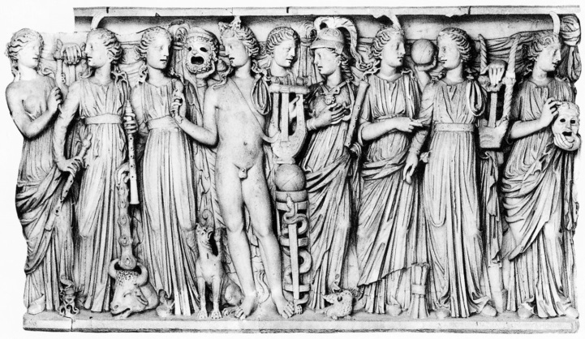
Homeric Hymn to Hermes: True Lies
Hermes’ Bee Maidens:
“When they are inspired by eating golden honey,
They cheerfully wish to proclaim the truth –
But if they are deprived of the gods’ sweet food,
They tell lies as they swarm all together.
(Homeric Hymn to Hermes, 560-63).
The Muses:
“We know how to tell lies that look like the truth, but we can speak the truth when we want to.” (Hesiod, Theogony 27-28)
ἴδμεν ψεύδεα πολλὰ λέγειν ἐτύμοισιν ὁμοῖα,
ἴδμεν δ' εὖτ' ἐθέλωμεν ἀληθέα γηρύσασθαι

Slide 25
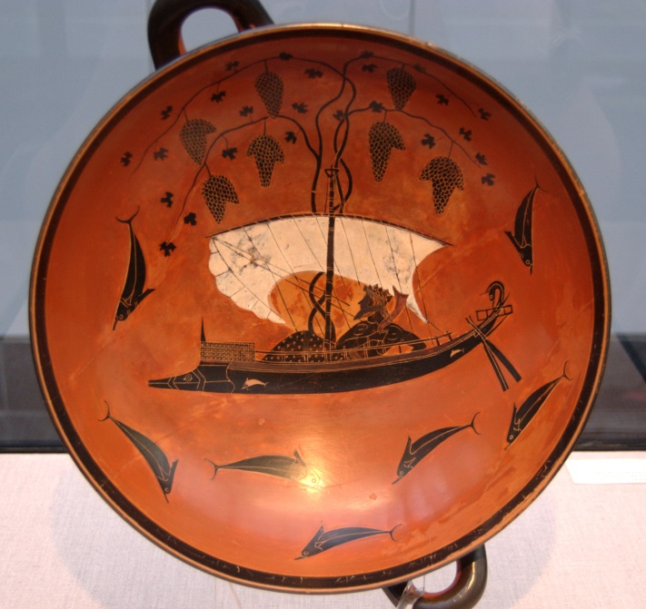
Homeric Hymn to Dionysus
Then vines stretched all over atop the sail,
hanging down with thick clusters of grapes.
Dark ivy twisted around the mast
blooming with flowers, rich berries sprang out
and the oarlocks wore garlands. Seeing all that,
the crew told the helmsmen to head landward.
But in the ship’s bow, the god appeared to them
as a terrible lion and gave a mighty roar.
Performing wonders midship, he made a shaggy bear
rear up, raging, while the lion glared ferociously
from the high deck. The men fled in fear to the stern,
where they clustered panic-stricken around
the sober-minded helmsman. With a sudden leap,
the lion seized the captain. Then all the rest,
fleeing their doom, dove into the glistening sea
and became dolphins. (38-53)

